Slide 1
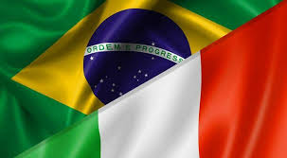
Italian Food in Brazil
Capstone Project - The Battle of Neighborhoods (Week 1-2)

Slide 2
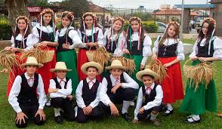
Italian Food in Brazil

Slide 3

Italian Food in Brazil
Background
Italian immigration to Brazil peaked between 1880 and 1930. Italo-Brazilians are spread mainly across the southern and southeastern states of Brazil. Italo-Brazilians are descendants of the huge mass of Italian immigrants who arrived in Brazil between 1870 and 1960. There are no concrete data on the number of descendants of Italians in Brazil. Immigration directly influenced the local cuisine of the southern provinces of Brazil, a region that received the greatest number of people. The city of Rio de Janeiro, despite not having received a large number of immigrants, was influenced by the tourism of Italian citizens, who periodically visit the city.

Slide 4
Italian Food in Brazil
Background
The rich and varied Italian cuisine, distinct in the various regions of the country, influenced the cuisine of practically the rest of the world. In the case of Brazilian cuisine, for example, the influence occurred through Italian immigration in the period between 1880 and 1930. Immigrants mixed the flavors and aromas of the homeland with the ingredients offered by the new land, adding the recipes from the different regions of Italy. developing them on Sunday lunches, which brought together several families, from different regions, in the same backyard. In Brazil there are many Italian restaurants with a menu full of delicious pasta, but for those who want to enjoy a good and unhealthy meal, it is advisable to pay attention to two important points: quality of the place and quality of food.

Slide 5
Italian Food in Brazil
Business Problem
Italian restaurants are spread out in large Brazilian centers, which increases competition. That way, we reach the big goal.
If a company specialized in food needs a consultancy on opening a restaurant in a Brazilian capital, which capital to indicate? If the big prerequisite is the opening of a restaurant in a populous region with little competition, which city should we indicate.
A restaurant consultancy will help the company to better understand its reality, bring a new view on the competition and lead the company strategically to the creation of a new establishment, which will help in obtaining results.

Slide 6
Italian Food in Brazil
Data section
Based on immigration surveys (http://www.imigrantesitalianos.com.br), the most populous Brazilian capitals with the largest number of Italian immigrants were selected:
• Sao Paulo
• Porto Alegre
• Florianópolis
• Curitiba
• Rio de Janeiro
Such data help in the application analysis for the opening of a new restaurant.

Slide 7
Italian Food in Brazil
Methodology section
We will use the FourSquare API to collect data about restaurants in five major Brazilian cities. The data are plotted on a map to assist in the analysis of distance between restaurants, a prerequisite of the analysis for starting a business. The quadrangular limits us to a maximum of 100 locations per consultation. The analysis focused only on the five cities mentioned, which were plotted to facilitate the analysis. Then, to obtain an indicator of the density of Italian restaurants, the central coordinate of the locations was calculated to obtain the average values of longitude and latitude. Then, I averaged the Euclidean distance from each location to the average coordinates. That was my indicator; average distance to the average coordinate.

Slide 8
Italian Food in Brazil
Results
Below, we can see that all cities have a large number of Italian restaurants, and that competition is strong in the neighborhood. The maps were generated in the geoplot with folio:
Total number of italian food places in São Paulo, SP = 188
Showing Top 100
Total number of italian food places in Porto Alegre, RS = 87
Showing Top 100
Total number of italian food places in Florianópolis, SC = 68
Showing Top 100
Total number of italian food places in Curitiba, PR = 104
Showing Top 100
Total number of italian food places in Rio de Janeiro, RJ = 115
Showing Top 100

Slide 9
Italian Food in Brazil
Below, we can see that all cities have a large number of Italian restaurants, and that competition is strong in the neighborhood.
The maps were generated in the geoplot with folio:
São Paulo, SP
Mean Distance from Mean coordinates
0.03834513392561405
Porto Alegre, RS
Mean Distance from Mean coordinates
0.03106063987001945
Florianópolis, SC
Mean Distance from Mean coordinates
0.08019835743825189
Curitiba, PR
Mean Distance from Mean coordinates
0.027956087712631295
Rio de Janeiro, RJ
Mean Distance from Mean coordinates
0.09823943423737182

Slide 10
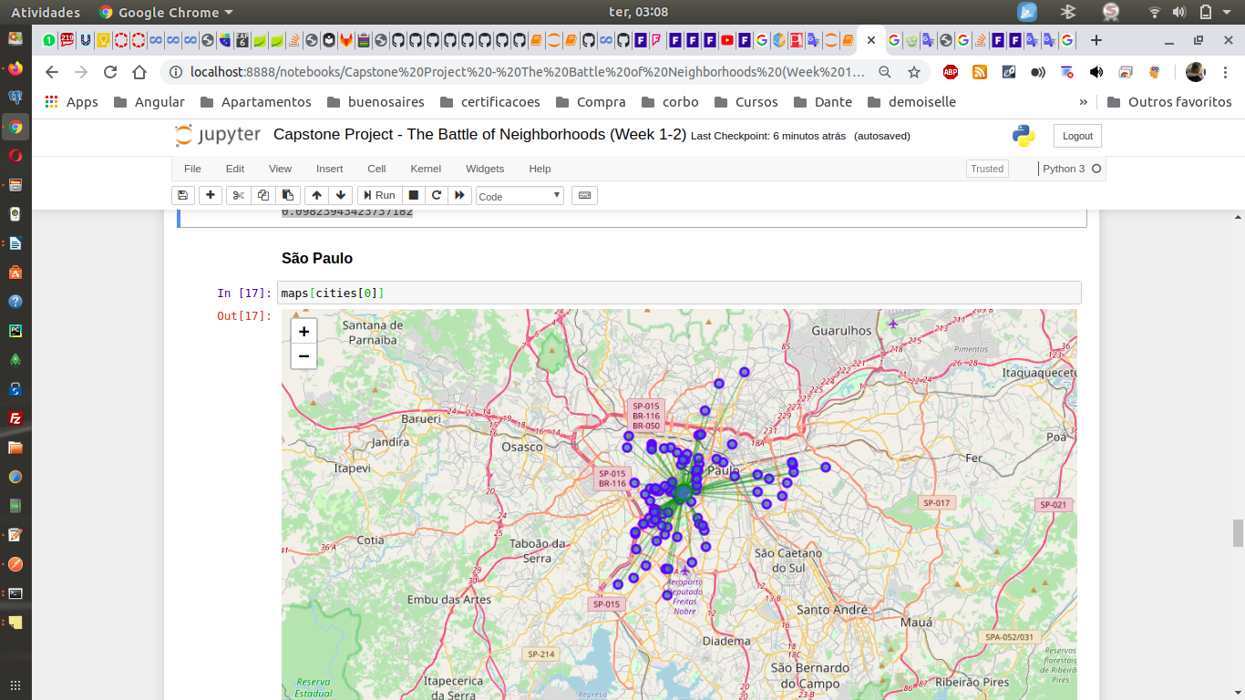
Italian Food in Brazil

Slide 11
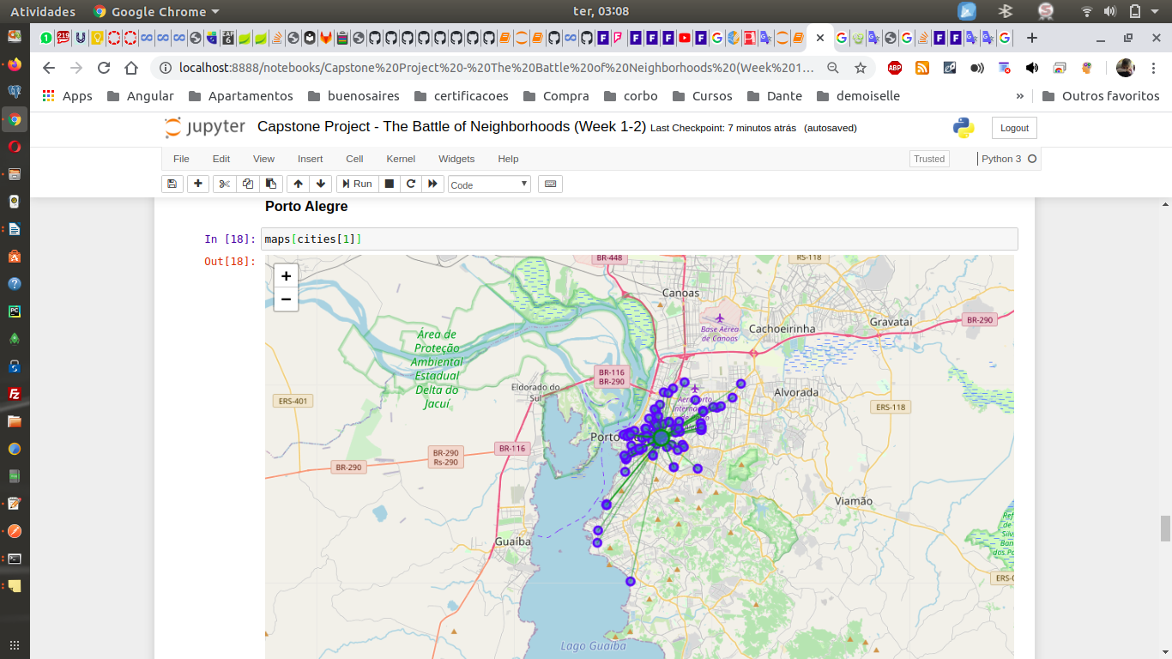
Italian Food in Brazil

Slide 12
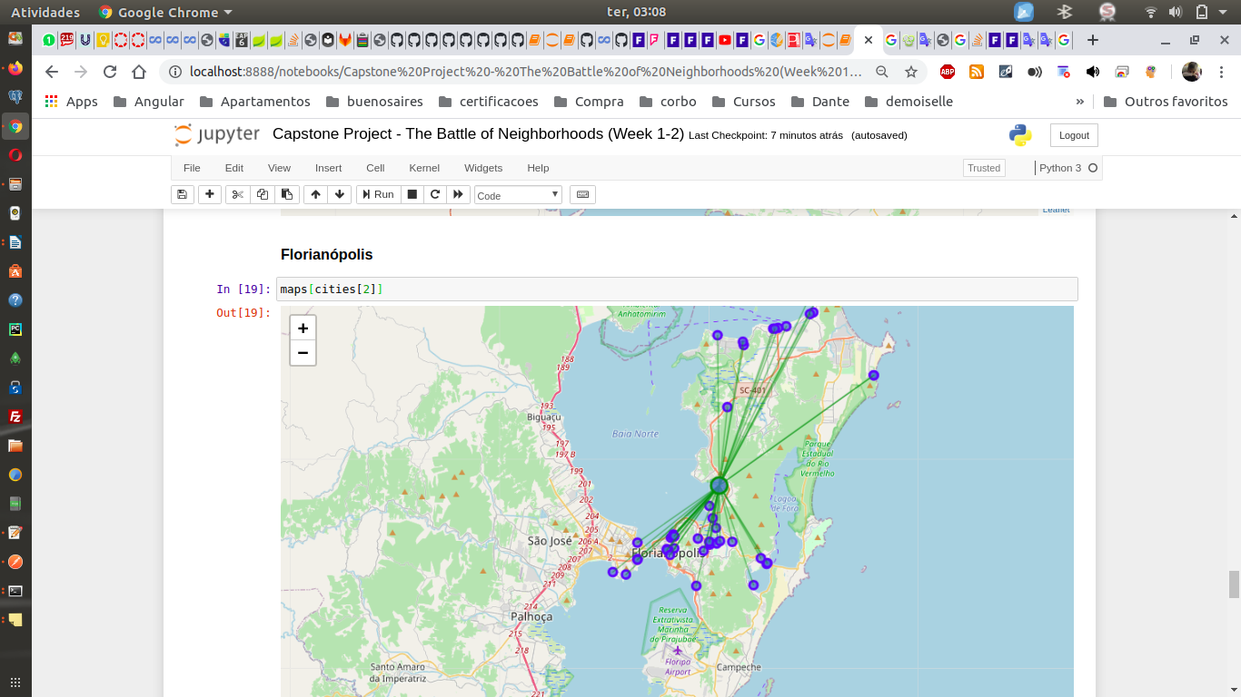
Italian Food in Brazil

Slide 13
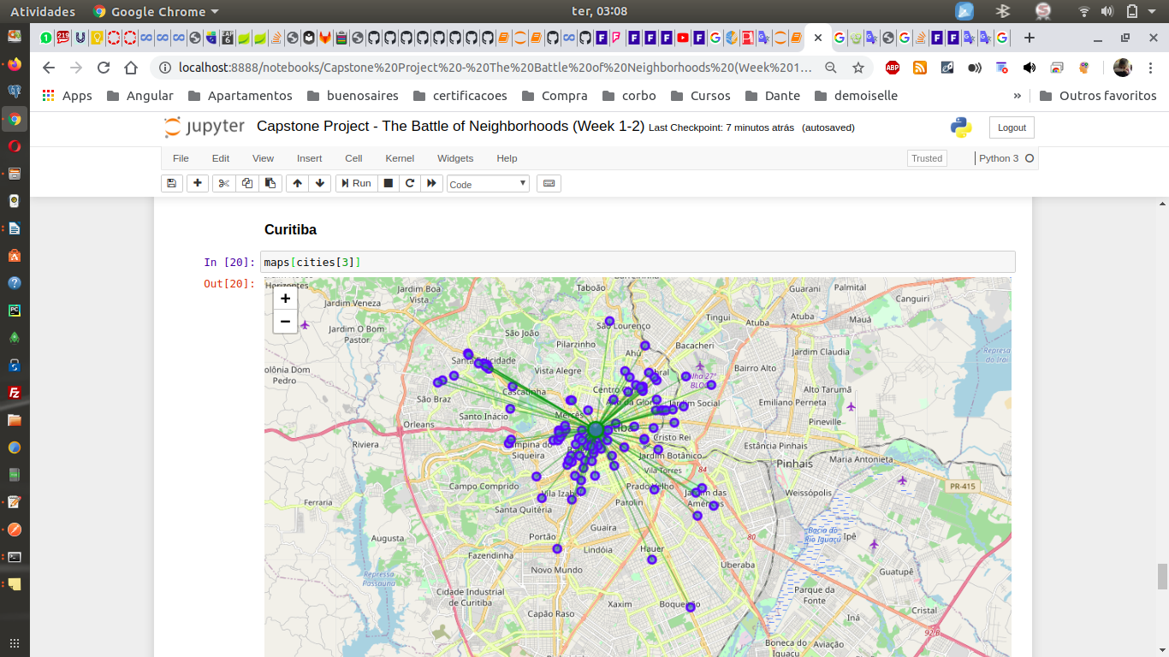
Italian Food in Brazil

Slide 14
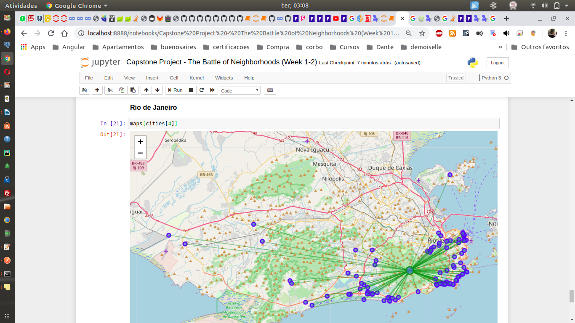
Italian Food in Brazil

Slide 15
Italian Food in Brazil
Results - Mean Distance from Mean coordinates:
• Curitiba, PR: 0.027956087712631295;
• Porto Alegre, RS: 0.03108649945434047;
• São Paulo, SP: 0.03834513392561405;
• Florianópolis, SC: 0.07987321369324735;
• Rio de Janeiro, RJ: 0.09823943423737182

Slide 16
Italian Food in Brazil
Discussion
We can see that São Paulo is the city with the largest number of establishments specializing in Italian food. The cities of southern Brazil also have a significant number of establishments. Another important factor is the population of these capitals, the most significant of which are São Paulo and Rio de Janeiro, respectively. We visually perceive that the density is concentrated in the shopping centers of these capitals, except in Rio de Janeiro, where the restaurants are far away. To get a concrete measure of this density, we will use some basic statistics. I will get the average location of the establishments Next, I will take the average distance from the locations to the average coordinates. In a simplified way, Italian restaurants are crowded in most capitals, except in Rio de Janeiro.

Slide 17
Italian Food in Brazil
Conclusion
Taking into account that the consultancy was hired to analyze the best city for opening a restaurant away from the competition, we easily concluded that Rio de Janeiro is the only city with Italian food on every corner. That way, there is plenty of space to cook pasta and make money away from the competition in all other cities. Buon appetito!

Slide 18
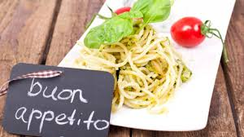
Italian Food in Brazil

